Slide 1
Mathematical Modelling of a single Neuron
An internship project
R.G.Sriya
SC16B115
Guided by Dr.N.Selvaganesan

Slide 2
WORKFLOW
Hodgkin Huxley Model
Voltage clamp experiments
Numerical methods used to solve the model:
Euler’s method
Runge_Kutta method
Predictor- Corrector method
ODE45
Comparison of models
Results obtained using MATLAB

Slide 3
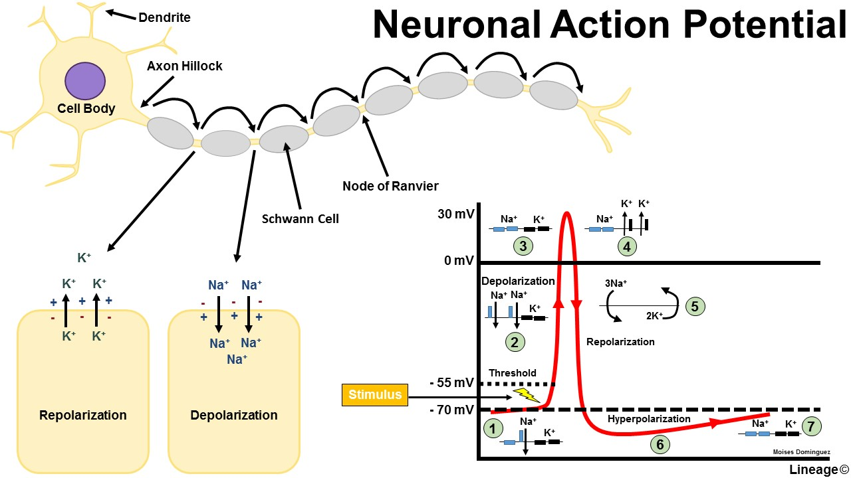
Introduction

Slide 4
This model is a simulation of single neuron’s action potential using Matlab
This model is developed using Hudkin-Huxley model.

Slide 5
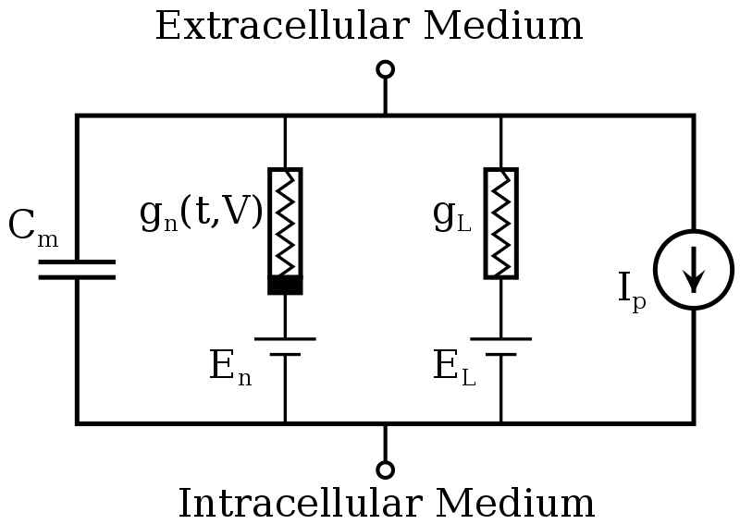
Hodgkin–Huxley model

Slide 6
The Hodgkin–Huxley model, or conductance-based model, is a mathematical model that describes how action potentials in neurons are initiated and propagated.
It is a set of nonlinear differential equations that approximates the electrical characteristics of excitable cells such as neurons and cardiac myocytes.
It is a continuous-time dynamical system.
Alan Hodgkin and Andrew Huxley described the model in 1952 to explain the ionic mechanisms underlying the initiation and propagation of action potentials in the squid giant axon.

Slide 7
Conductivity is equivalent to permeability and also it is variable with channel opening and closing.
En is equivalent to the electrostatic potential that drives during natural diffusion.
El is equivalent to the leakage of unspecific channels.
Ip represents the pumping of Na ions into the membrane during excitation.
Cm is the membrane capacitance
Vm

Slide 8
parameters
m,n,h - gates
Cm- membrane capacitance
I- external current stimulus
gNa,gK,gl- conductances of sodium,potassium and leak channels
ENa,EK- equilibrium potentials of sodium and potassium ions
Alpha,beta-rate constants

Slide 9
The voltage clamp experiment
As they kept the voltage constant, the conductance of the channel increased to a steady value dependant on the initial voltage .
Their most significant finding was that the rate at which the conductance reached its maximum depended greatly on the clamped voltage.

Slide 10
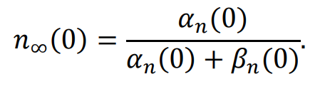
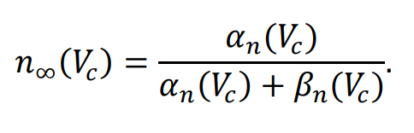
Initially, the resting value of n is
But as the voltage is clamped to a different voltage, Vc, the steady state becomes

Slide 11



A solution can then be found mathematically to solve
with the above restraints. This simple solution is an exponential of the form
Where
Trial-and-error method to find the proper order of the gates sigmoidal conductance found from previous results.

Slide 12
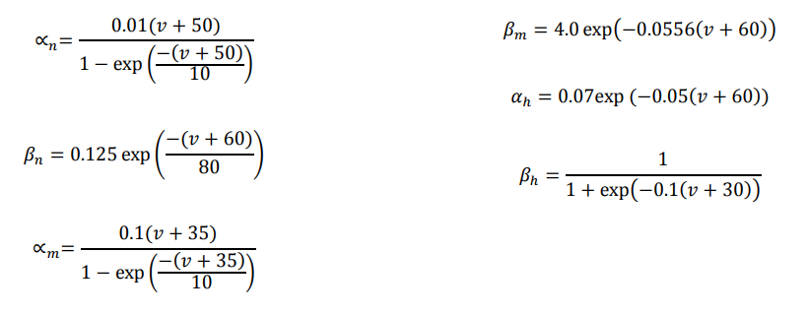
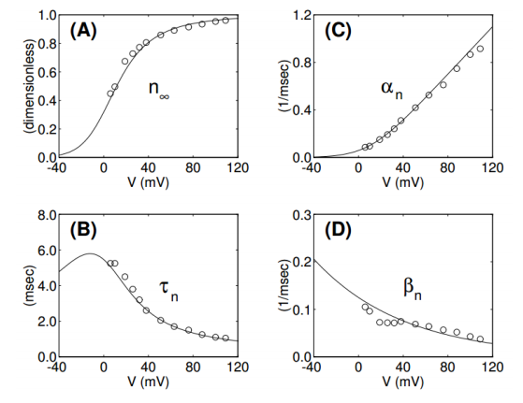

Slide 13
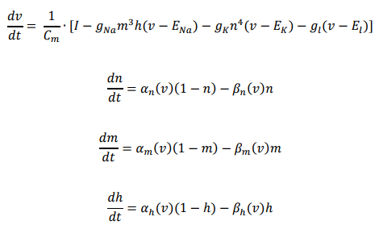
Equations used

Slide 15
Parameters
Cm=0.01µF/cm^2 Found experimentally
ENa=55.17mV
EK=-72.14mV
El=-49.42mV
GNa(max)=1.2mS/cm^2
GK(max)=0.36mS/cm^2
Gl(max)=0.003mS/cm^2

Slide 16
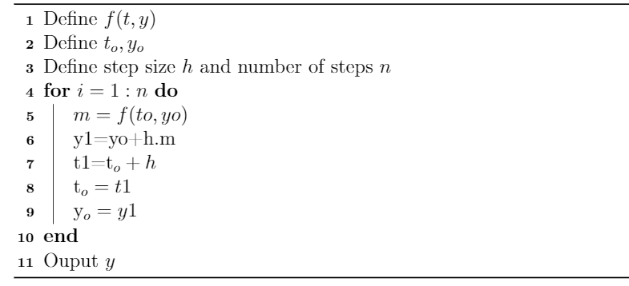
Algorithm for different numerical approaches
EULER METHOD

Slide 17
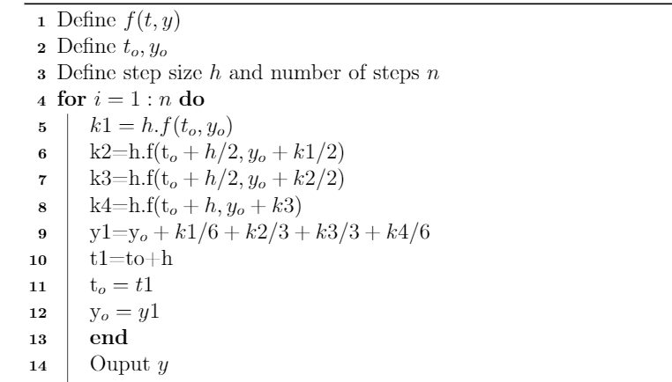
RUNGE-KUTTA METHOD

Slide 18
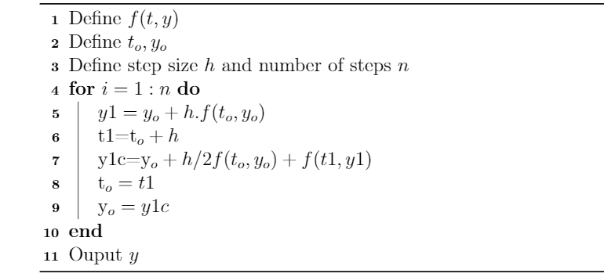
PREDICTOR_CORRECTOR METHOD

Slide 19
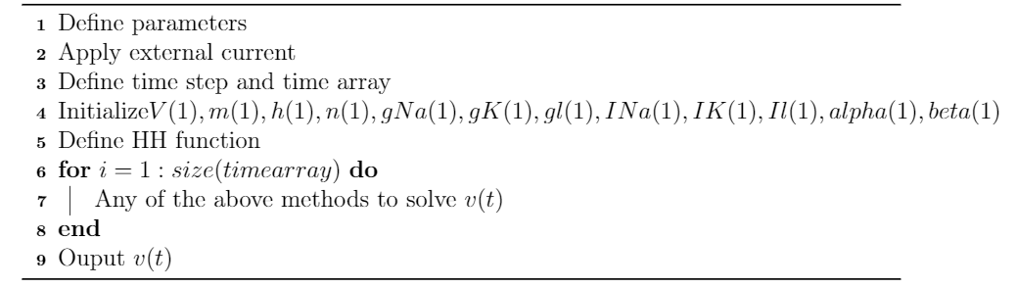
Algorithm for solving HH model
For the ODE45,
Define HH, alpha and beta functions

Slide 20
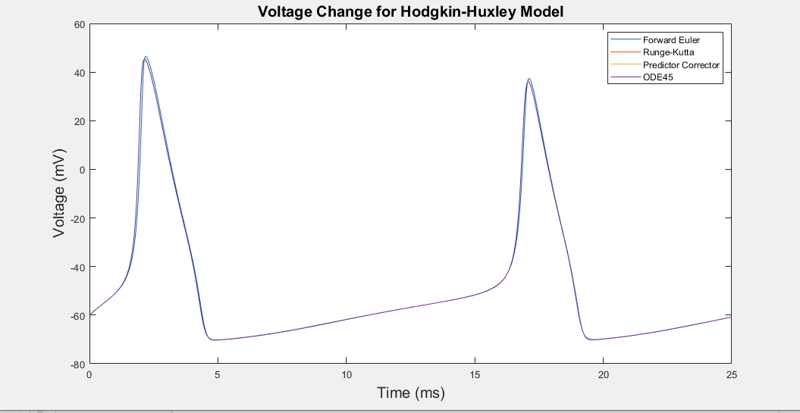
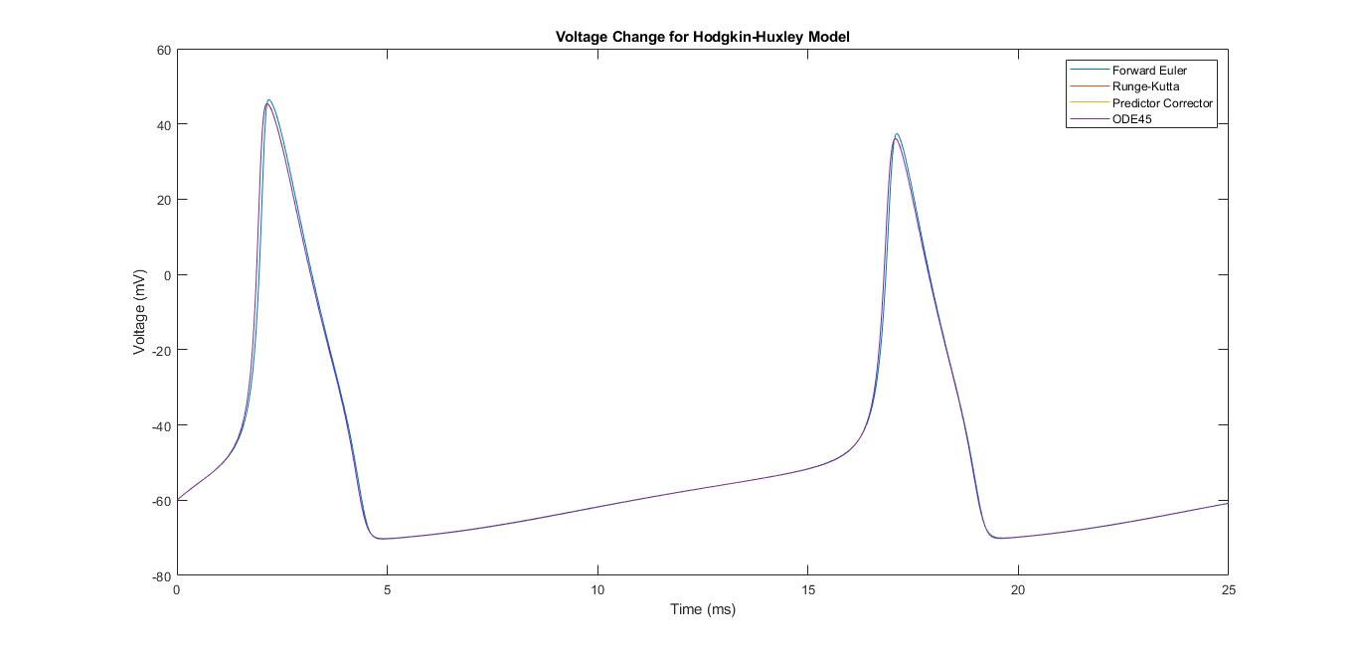
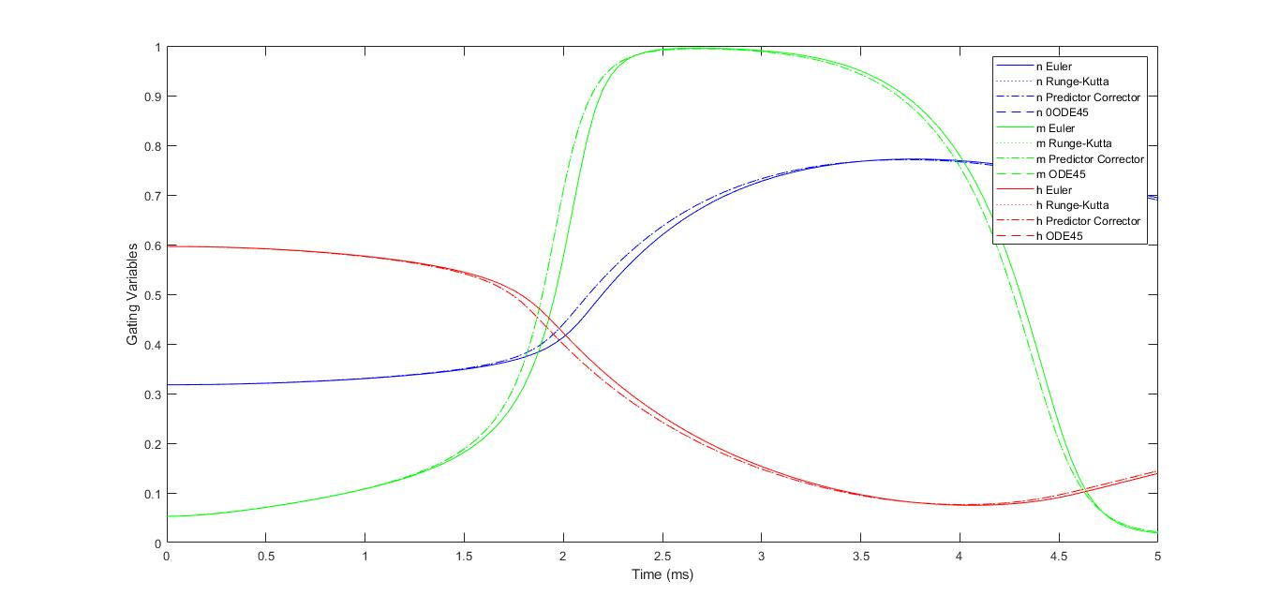
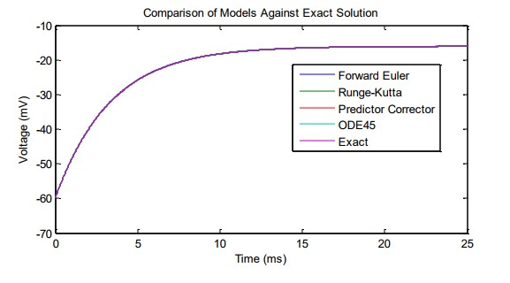
Results

Slide 21
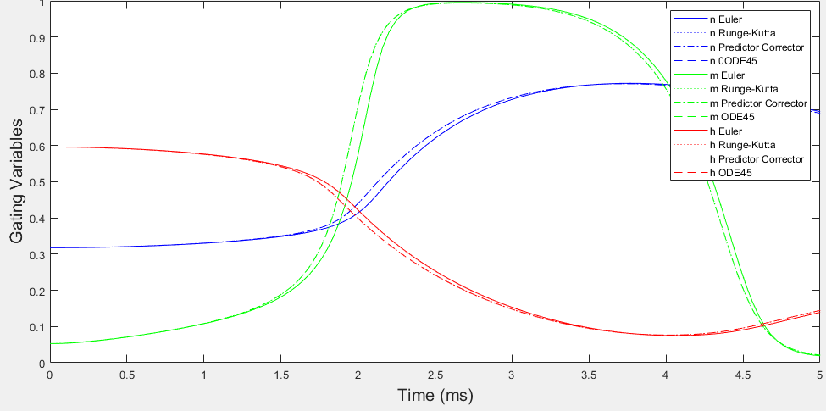

Slide 22


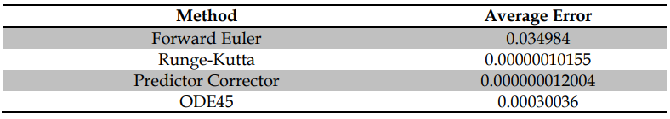
By setting conductances to zero

Slide 23
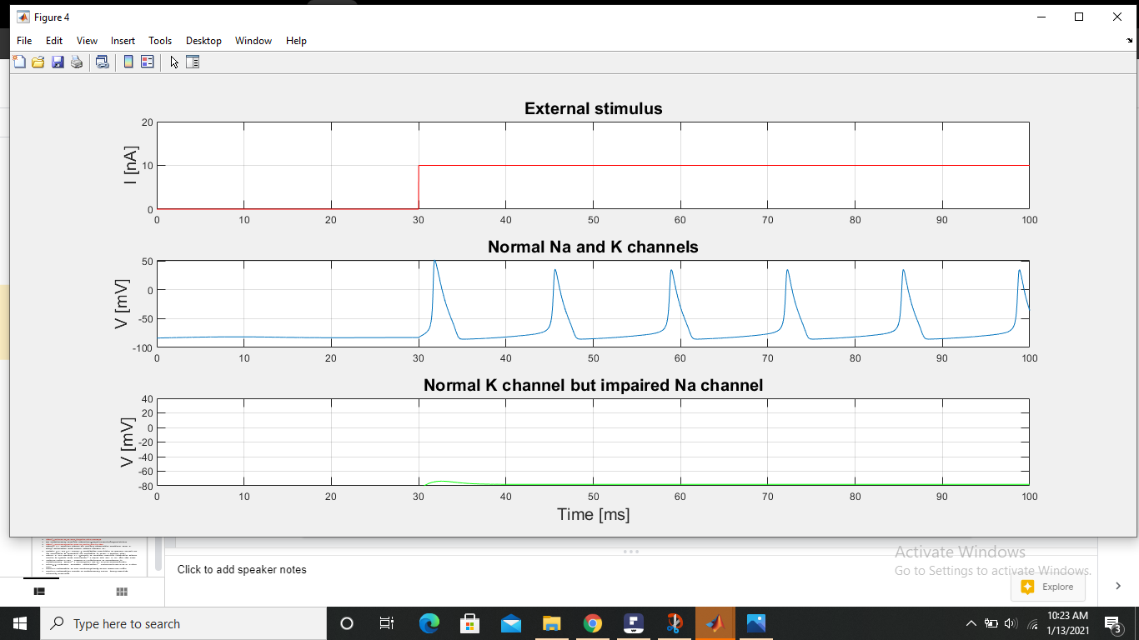
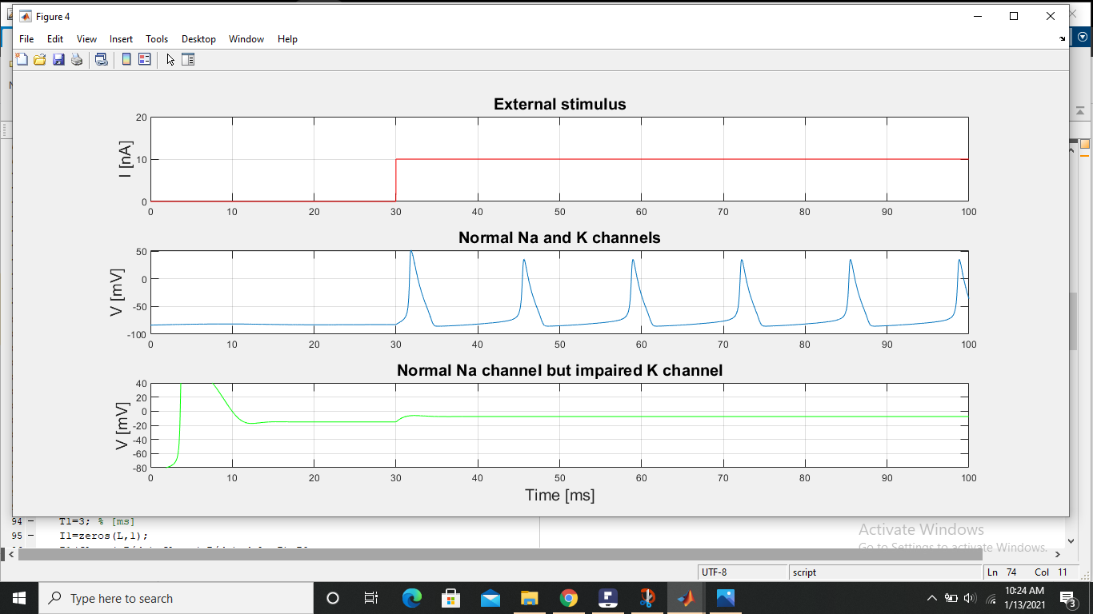
Further analysis
Channel impairment

Slide 24
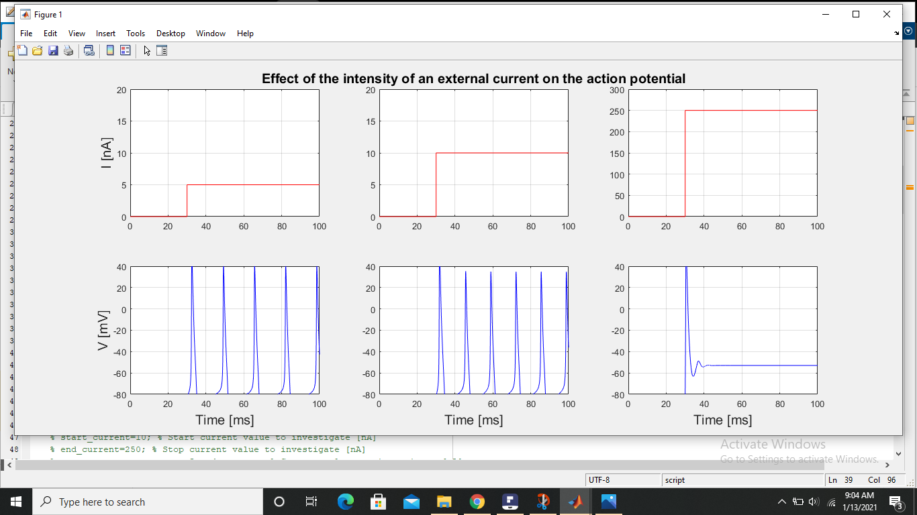
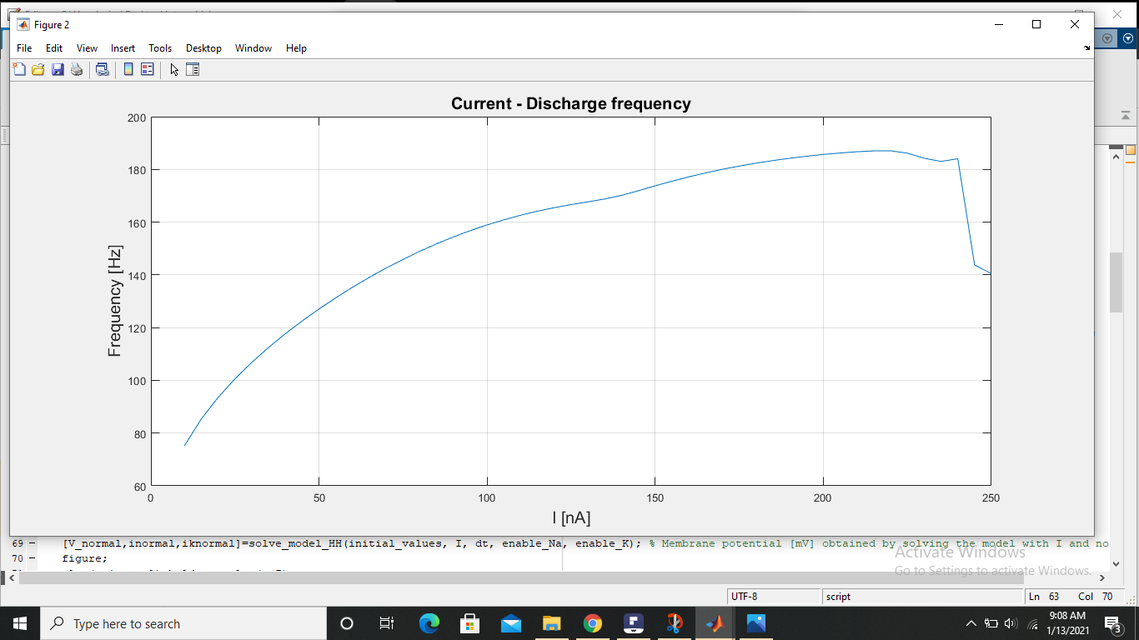
Effect of current intensity

Slide 25
Conclusions and future work
Information about neural signaling-all or none
The Runge-Kutta and predictor-corrector methods gave the most accurate results
Relation between frequency and current intensity
Response to time varying stimuli
Learning algorithm
Neural networking and energy efficiency

Slide 26
References and citations
https://sci-hub.do/10.1113/jphysiol.1952.sp004764
The Hodgkin-Huxley Model(Its Extensions,Analysis,Numerics)-RyanSiciliano
https://neuronaldynamics.epfl.ch/online/Ch2.S2.html
Butcher, J., Numerical Methods for Ordinary Differential Equations, 2003, J. Wiley: Chinchester, West Sussex, England Hoboken, NJ.
Hodgkin, A.L. and A.F. Huxley, A quantitative description of membrane current and its application to conduction and excitation in nerve. J Physiol, 1952.
Butera, R. and McCarthy, M., “Analysis of real-time numerical integration methods applied to dynamic clamp experiments,” J Neural Eng, vol.1, pp. 187– 194, 2004.
Foster,W.,Ungar,L.,and Schwaber,J.,“Signiﬁcance of conductances in Hodgkin-Huxley models,” J Neurophysiol, vol.70, no.6,pp.2502–2518,1993.
Prinz,A.A.,“Neuronal parameter optimization,” Scholarpedia,vol.2,no.1,p.1903, 2007.
Cronin,J.,Mathematics of cell electrophysiology.Marcel Dekker,Inc.,1981.
Cronin,J.,Mathematical aspects of Hodgkin-Huxley neural theory.Cambridge University Press,1987

